Slide 1

Programming Robot Car
By: Roberto Nunez

Slide 2
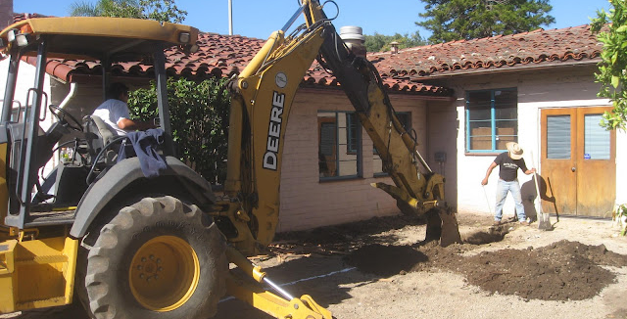
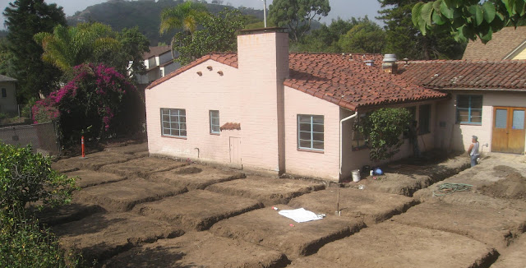
House Trenches
Used for plumbing, electricals, and gas.
Serve as Foundation footings to distribute the weight where required.
Rebar is often placed inside the trenches to reinforce the concrete.

Slide 3
Problem?
Requires at minimum three men and 20 minutes per house.
Assuming a private company with one of these men being the owner, and an average of 20 new houses per month (at $25/hour):
20 min * 20 houses / 60 min = ~7 hours
7 hours * $25/hour = $175
$175 * 12 months = $2100/year
-$4200/year to spray paint dirt.

Slide 4
Solution
Automation.
Employees can perform more technically challenging tasks.
Owner saves both time and money.

Slide 5
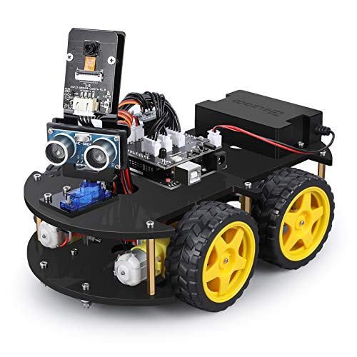
The Hardware
ELEGOO smart robot v4.0
Test and code at a smaller scale with a inexpensive robot to then transfer (both hardware and software) to a more rugged robot.
The scale ratio is 1:25.

Slide 6
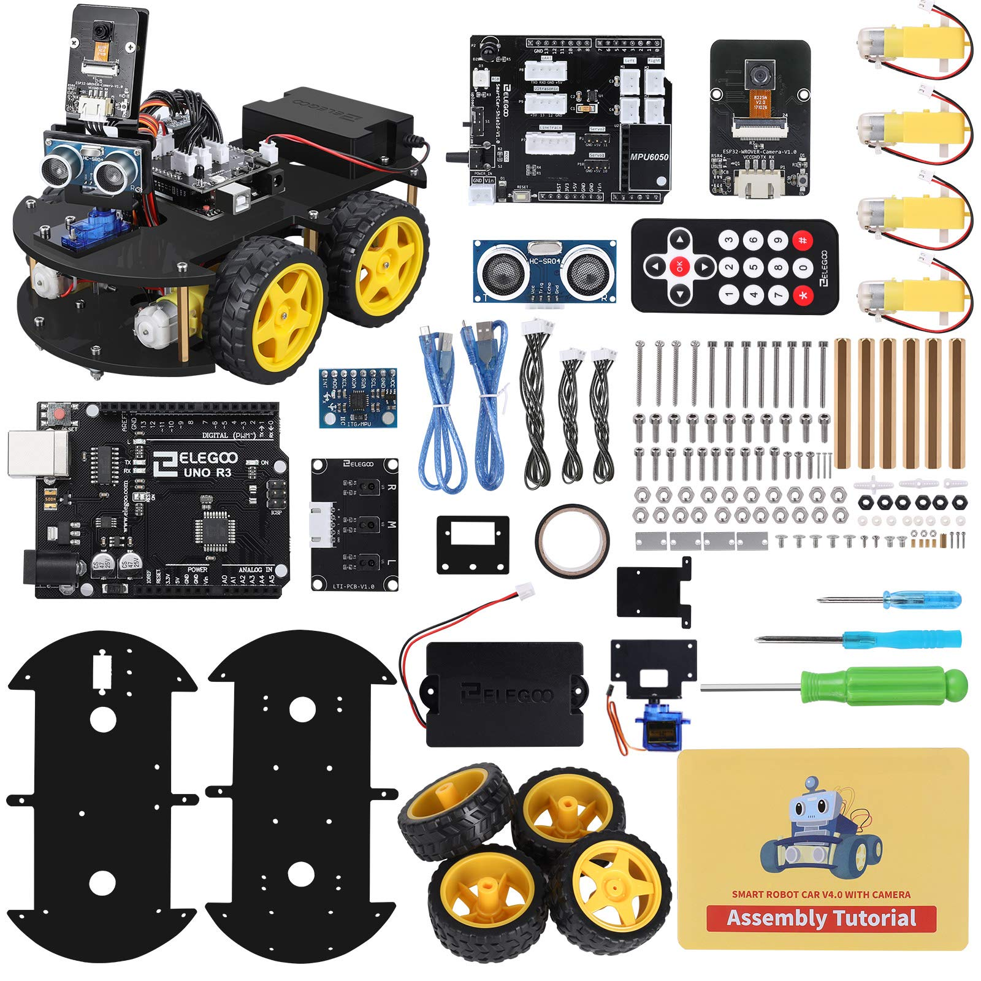
The Hardware cont.
Controller: ELEGOO UNO R3
Distance Measuring Method: Ultrasonic Ranging Sensor
Motor-Driven: Dual-channel TB6612 Driver Chip
Single-axis gimbal: SG90 Servo
Tracking method/ controller: Infrared Photoelectric Sensor
Visual: Camera Module
Four DC motors

Slide 7
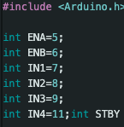
Preparation
Arduino.h: Arduino core library (“digitalWrite(), analogRead(), pinMode())
ENA & ENB: Enable pins for controlling motor speed.
IN1, IN2, IN3, & IN4: Pins for each of the four DC motors.
STBY: used to enable/disable the motor driver.

Slide 8
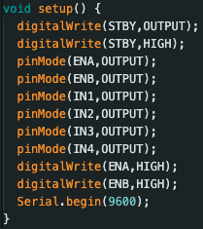
Preparation cont.
The setup function prepares the robot to receive code.
DdigitalWrite sets the motor driver to high and enables the pins to send voltage to the DC motors.
All pins are set to output using pinmode, this allows the expansion bard to send commands to the motors.
Serialbegin sets the baud rate, communication between the bard and the motors, at 9600 bits per second.

Slide 9
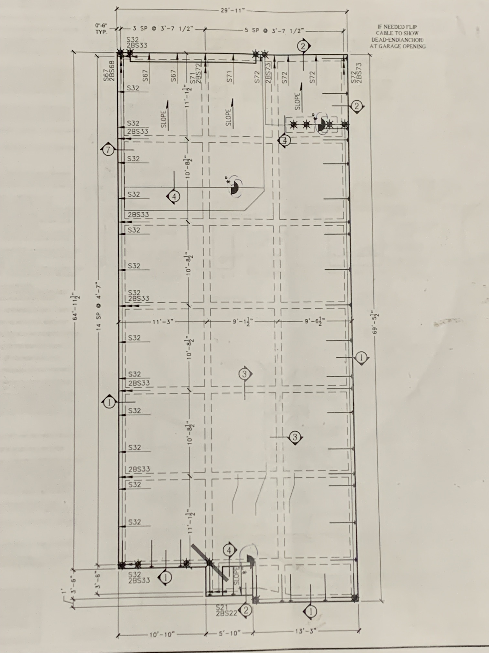
Objective
Use existing hosue plan and scale down measurements.
Drive the dimensions of the house as well as the squares inside the house.

Slide 10
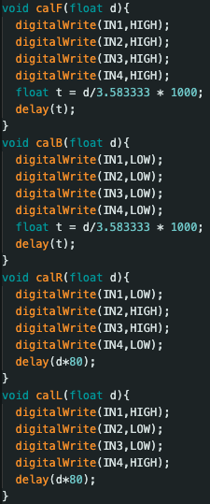
Robot Movement
Must be able to move the robot Forward, backward, Left, and Right.
Forward and Reverse delay is based on the amount of time required to traverse a given distance.
Moves the same way a Track Tractor moves.
Right and Left delay is based on a 45˚ movement every 80 milliseconds.

Slide 11
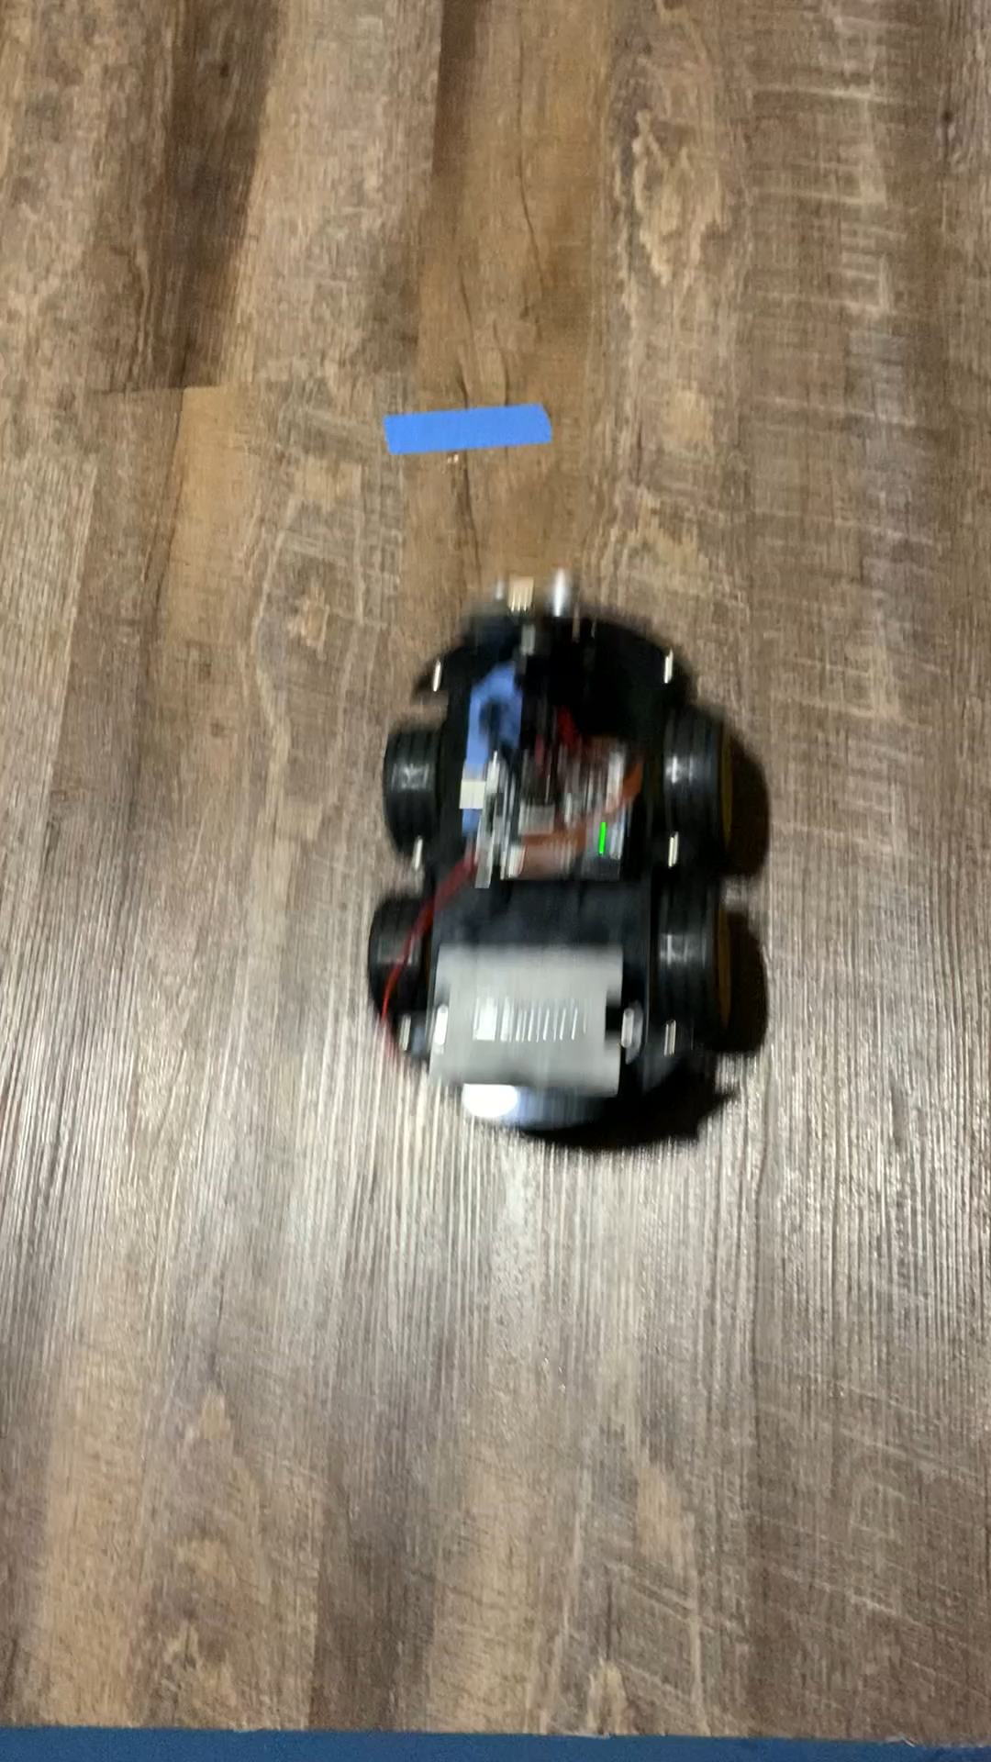
Testing Movement
Test proved to be a success.
Stop-Start Function needed to be created in order to stop voltage being carried over to the next command.

Slide 12
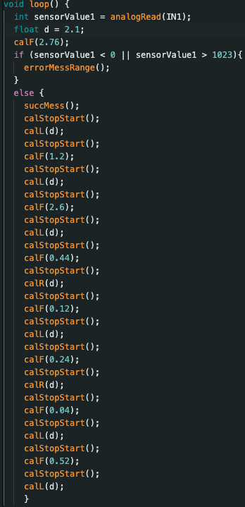
Outer Perimeter
If-else statement to check for valid sensor value.
Calling movement functions with scaled-down measurements being passed in.
Stop-Start function required between every function call.

Slide 13
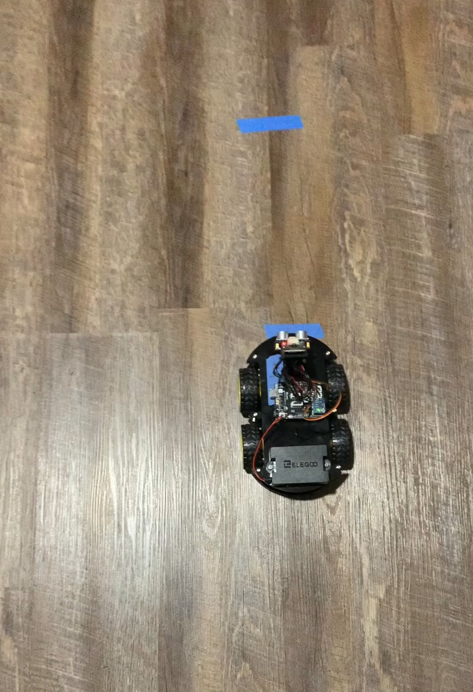
Testing Outer Perimeter
Test proved to be successful.
Now to work on the inside of the house.

Slide 14
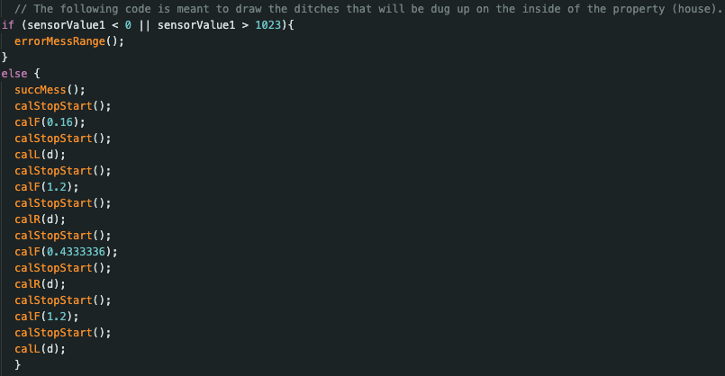
Current Work
Hard-coding the inside squares.
Modifying supplemental ultrasonic sensor code (from ELEGOO) to work with my current code.

Slide 15
Current Issues
Static vs Dynamic code
Terrain Sensitive
Uneven wheels – Two of the motors aren’t properly placed.
Ultrasonic sensor code not working – need to test and see if the ultrasonic sensor is working by using supplemented demo code from ELEGOO.

Slide 16
Future Plans
Convert static code into more dynamic code that adjusts based on different floor plans and terrains.
Built to a much larger scale but still small and light enough to be carried by one person. Should also be durable enough for the environment. (+100˚F temperatures & rain).

Slide 17
Thank You.
Questions?

